Slide 1
Practicing Personalized Evidence-based Medicine in CLL through Risk Stratification and Patient Education
Jeffrey Jones, MD
The Ohio State University
Columbus, Ohio
Beth Faiman, PhD, CNP Cleveland Clinic Taussig Cancer Institute
Cleveland, Ohio
Heidi D. Finnes, PharmD, BCOP
Mayo Clinic Cancer Center
Rochester, Minnesota
Notes:
Practicing Personalized Evidence-based Medicine in CLL through Risk Stratification and Patient Education
© 2017 MediCom Worldwide, Inc.

Slide 2
Learners are welcome to use and share these slides in full or in part for educational purposes in noncommercial discussions with colleagues or patients
The materials presented may discuss uses and dosages for therapeutic products that have not been approved by the United States Food and Drug Administration. Readers should verify all information and data before treating patients or using any therapies described in these materials
The materials published reflect the views of the authors and not those of MediCom Worldwide, Inc. or the companies providing educational grant support
These slides may not be published, posted online, or used in commercial presentations

Slide 3
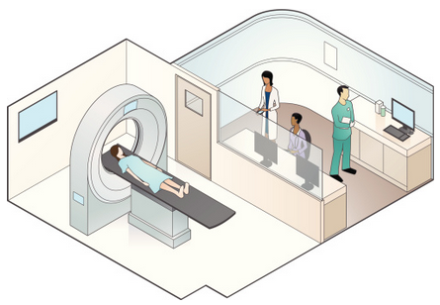
Chronic Lymphocytic Leukemia (CLL) is the Accumulation of Immature Lymphocytes
Indolent (slow-growing) cancer
Relapsed Disease:
Disease recurrence
Refractory Disease:
Fail to achieve an objective response to therapy (≥ PR)
Relapse within 6 months from completing therapy
Primarily in blood and bone marrow
Later stages in lymph nodes, spleen and/or liver
Lymph node-predominant disease is small lymphocytic lymphoma (SLL)
Notes:
Practicing Personalized Evidence-based Medicine in CLL through Risk Stratification and Patient Education
© 2017 MediCom Worldwide, Inc.

Slide 4
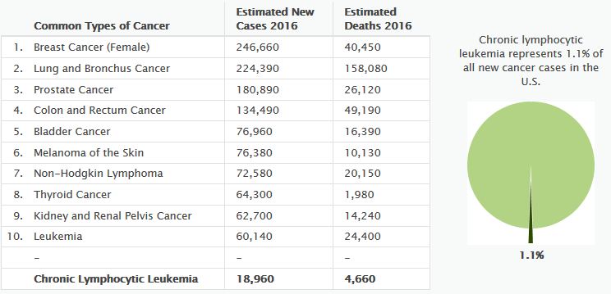
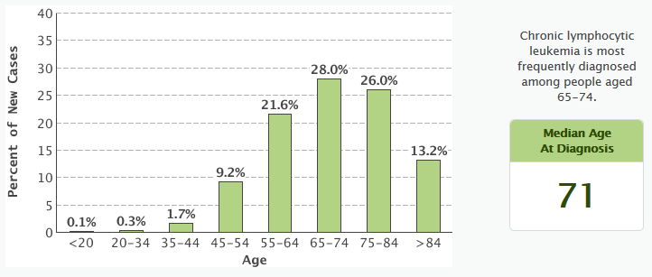
CLL Primarily Affects Older Patients
CLL is the most common leukemia diagnosed in Western adults
More than 50% of patients are older than age 70 when diagnosed
NIH Seer Database. http://seer.cancer.gov/statfacts/html/clyl.html.
Notes:
Practicing Personalized Evidence-based Medicine in CLL through Risk Stratification and Patient Education
© 2017 MediCom Worldwide, Inc.

Slide 5
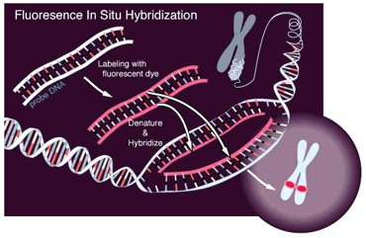
Cytogenetics Plays an Important Role in CLL
Predictors of CLL Disease Course
Age
Genetics
Fitness
FISH panel for recurrent cytogenetic abnormalities is the most important single test in CLL for prognosis and treatment
Until recently, there were limited treatment options for the following patients, as measured by FISH:
Older Patients
Comorbid Patients
High-risk Patients
Mertens D. J Clin Oncol. 2014;32(9):869-872.
Notes:
Practicing Personalized Evidence-based Medicine in CLL through Risk Stratification and Patient Education
© 2017 MediCom Worldwide, Inc.

Slide 6
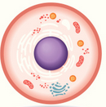
CLL Prognosis is Influenced by Clinical-, Cellular/Genetic- and Patient-Specific Factors
Prognostic Factors |  | Parameter
 | Evaluation | Staging (Rai or Binet)
 | Serum Markers | β₂ microglobulin Thymidine kinase
 | Investigations | Lymphocyte doubling time
 | Chromosomal Aberrations | Deletion 17p [del(17p)] Deletion 11q [del(11q)]
 | Mutations | IGHV gene somatic hypermutation status TP53 mutation
 | Protein Expression | CD38 ZAP-70
 | Demographics | Age Gender
 | Health Status | Fitness Comorbidities
Clinical
Cellular
Patient
Mertens D. J Clin Oncol. 2014;32(9):869-872.
Notes:
Practicing Personalized Evidence-based Medicine in CLL through Risk Stratification and Patient Education
© 2017 MediCom Worldwide, Inc.

Slide 7
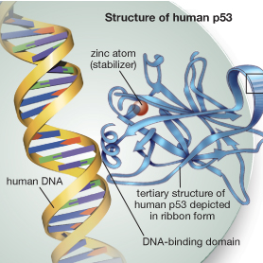
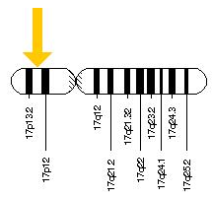
Deletion 17p [del(17p)] Increases Proliferation of Leukemic Cells
Tumor protein 53 gene (TP53) codes for a tumor suppressor protein (p53)
p53 binds damaged DNA, signaling either repair or apoptosis
Deletion of 17p, results in loss of TP53, leading to:
Decreased production of p53
Proliferation of cells with damaged DNA and possible oncogenic mutations
National Library of Medicine (US). http://ghr.nlm.nih.gov/gene/TP53.; Encyclopædia Britannica Online. http://www.britannica.com/science/TP53/images-videos/The-p53-protein-prevents-cells-with-damaged-DNA-from-dividing/58075.
Notes:
Practicing Personalized Evidence-based Medicine in CLL through Risk Stratification and Patient Education
© 2017 MediCom Worldwide, Inc.

Slide 8
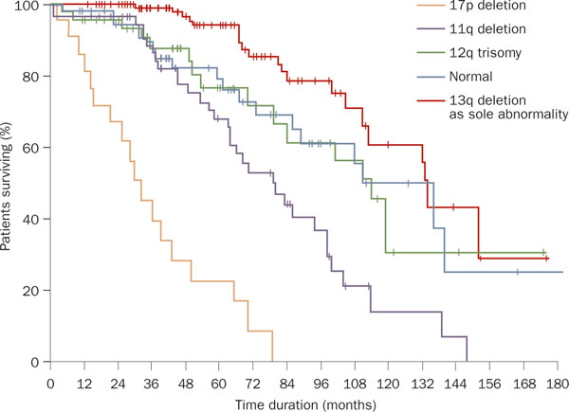
del(17p) Confers Poorer Survival in Patients with CLL
del(17p) uncommon in treatment-naïve CLL, BUT it results in:
Shorter time to 1st treatment
Increased death from disease
Poorer outcomes to standard therapy, including chemo-immunotherapy (eg, FCR)
Median survival 2-3 years from initial treatment
del(17p) Frequency
Therapy | del(17p)
CLL8¹ Frontline FC vs FCR | 8.2%
CLL3X² High-risk Allo-SCT | 18.1%
CLL2H³ F-Ref. Alemtuzumab | 30.1%
Döhner H, et al. N Engl J Med. 2000;343:1910-1916.
Line of Therapy^{1,2,3}
¹Stilgenbauer S, et al. Blood. 2014;123:3247-3254. ²Dreger P, et al. ASH 2012. Abstract 966. ³Dreger P, et al. Blood. 2013;121:3284-3288. ⁴Stilgenbauer S, et al. Hematology Am Soc Hematol Educ Program. 2010;2010:481-488.
Notes:
Practicing Personalized Evidence-based Medicine in CLL through Risk Stratification and Patient Education
© 2017 MediCom Worldwide, Inc.

Slide 9
Common Frontline Therapies (eg, FCR) Less Effective in CLL Patients with del(17p)
PFS
OS
Hallek M, et al. Lancet. 2010;376(9747):1164-1174.
Notes:
Practicing Personalized Evidence-based Medicine in CLL through Risk Stratification and Patient Education
© 2017 MediCom Worldwide, Inc.

Slide 10
Educating Patients/Caregivers is a Critical Component of del(17p) Testing
It is within the nurse’s scope of practice to:
Prognostic Factor | Results | Points
FISH | del(17p) mutation | 4
Serum β2 | >3.5 mg/dL | 2
Rai Stage | I-IV | 1
IGHV | Unmutated | 2
Age, years | >65 | 1
Provide patients with knowledge about their disease
Review individual risk and staging
Risk Category | Risk Score | 5-year OS
Minimal Risk | 0-1 | 93%
Low Risk | 2-3 | 79%
Intermediate Risk | 4-6 | 64%
High Risk | 7-10 | 23%
Review available treatment options in line with the treatment team
Rossi D, et al. Blood. 2014;123(14):2139-2147.; Parikh SA, et al. Semin Oncol. 2016;43(2):233-240.; Stilgenbauer S, et al. Blood. 2015;126:LBA-6.
Notes:
Practicing Personalized Evidence-based Medicine in CLL through Risk Stratification and Patient Education
© 2017 MediCom Worldwide, Inc.

Slide 11
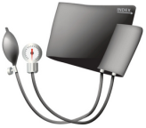
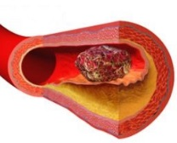
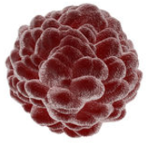
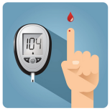
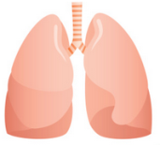
Non-CLL-Related Comorbidities are Independent Predictors of Survival
Comorbidity
Common
Severe
Study: Mayo Clinic (n=195 pts)
90% of pts had ≥1 comorbidity
HTN (46.1%)
Rheum (44.5%)
HLD (33.5%)
40% had ≥1 severe comorbidity
Atherosclerosis (13.9%)
Prior Cancer (13.9%)
DM (11.0%)
Respiratory (7.0%)
Meta-analysis: GCLLSG (n=554)
HTN=hypertension; Rheum=rheumatologic; HLD=hyperlipidemia; DM=diabetes mellitus
Survival was significantly impaired with either ≥2 comorbidities or severe comorbidity
Thurmes P, et al. Leuk Lymphoma. 2008;49(1):49-56.; Eichhorst B, et al. Leuk Lymphoma. 2009;50(2):171-178.
Notes:
Practicing Personalized Evidence-based Medicine in CLL through Risk Stratification and Patient Education
© 2017 MediCom Worldwide, Inc.

Slide 12
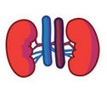
Cumulative Illness Rating Scale (CIRS) Can Help Better Characterize Biological Fitness
CIRS Severity Rating Scale
0 | No problem affecting that system
1 | Current mild problem not interfering with normal activity or past significant problem
2 | Interferes with normal activity and/or requires first-line therapy
3 | Severe problem and/or constant and significant disability and/or hard-to-control chronic problem
4 | Extremely severe problem and/or treatment is urgent and/or severe functional impairment or organ failure
Comorbidity scales can refine fitness assessment beyond performance status (eg, ECOG, Karnofksy)
CIRS rates severity of comorbidity by organ system
In many recent CLL trials, patients with CIRS ≥6 and creatinine clearance ≤60 mL/min were deemed “less fit”
Salvi F, et al. J Am Geriatr Soc. 2008;56(10):1926-1931.
Notes:
Practicing Personalized Evidence-based Medicine in CLL through Risk Stratification and Patient Education
© 2017 MediCom Worldwide, Inc.

Slide 13
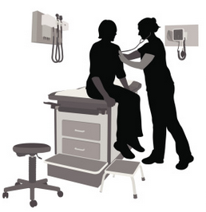
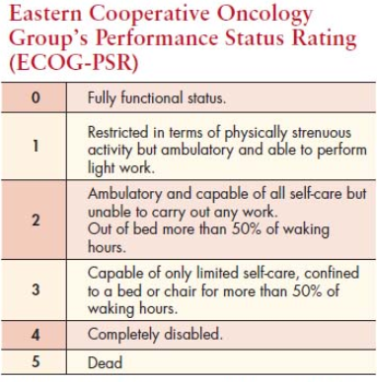
Nurses Play a Critical Role in Monitoring and Assessing for Comorbidities
Nurses assess for comorbidities in between visits with the provider
Comorbid assessment especially important because patients often older with poor cardiac, pulmonary and/or renal function
ECOG may be easier to use; patients know if they are up and about >50% of the time
When choosing therapy, consider:
Age
Functional status
Comorbid conditions
Prior therapy/response
Cancer Network. http://www.cancernetwork.com/oncology-nursing/facing-forward-meeting-rehabilitation-needs-cancer-surviviors.
Notes:
Practicing Personalized Evidence-based Medicine in CLL through Risk Stratification and Patient Education
© 2017 MediCom Worldwide, Inc.

Slide 14
Pharmacists Ensure Patient Safety by Assessing Combined Risk of Comorbidities and Therapy
Atrial Fibrillation | Bleeding Tendencies | Cytopenias/Infection
Ibrutinib | Ibrutinib | Bendamustine Chlorambucil Cyclophosphamide Fludarabine Idelalisib Pentostatin Obinutuzumab Ofatumumab Rituximab Venetoclax
Diarrhea/Colitis | Renal Impairment
Idelalisib | Chlorambucil Cyclophosphamide Fludarabine Pentostatin
Hepatic Impairment
Chlorambucil Cyclophosphamide Ibrutinib* Idelalisib¥ Venetoclax£
 | Tumor Lysis Syndrome
 | Ibrutinib Obinutuzumab Ofatumumab Rituximab Venetoclax
Hypertension
Ibrutinib
*Ibrutinib may be reduced to 140 mg once daily; ¥ single oral idelalisib doses tolerated in moderate/severe liver insufficiency; £ moderate to severe hepatic dysfunction leads to increased toxicity
Imbruvica [prescribing information]. Sunnyvale, CA: Pharmacyclics, LLC 2016.; Zydelig [prescribing information]. Foster City, CA: Gilead Sciences, Inc. 2014.; VENCLEXTA [prescribing information]. North Chicago, IL: AbbVie Inc. 2016.; Leukeran [prescribing information]. Research Triangle Park, NC: GlaxoSmithKline 2006.; Cyclophosphamide [prescribing information]. Deerfield, IL: Baster Healthcare Corporation 2013.; Fludara [prescribing information]. Wayne, NJ: Bayer HealthCare Pharmaceuticals, Inc. 2008.; Nipent [prescribing information]. Lake Forest, IL: Hospira, Inc. 2015.; Gazyva [prescribing information]. South San Francisco, CA: Genentech, Inc. 2016.; Arzerra [prescribing information]. East Hanover, NJ: Novartis Pharmaceuticals Corporation 2016.; Rituxan [prescribing information]. South San Francisco, CA: Genentech, Inc. 2016.; Bendeka [prescribing information]. North Wales, PA: Teva Pharmaceuticals, USA, Inc.
Notes:
Practicing Personalized Evidence-based Medicine in CLL through Risk Stratification and Patient Education
© 2017 MediCom Worldwide, Inc.

Slide 15
First-Line Treatment Options for Patients with del(17p)-Positive CLL
First-line Suggested Treatment Regimens†
(in order of preference)
Most experts would agree that del(17p) is best treated with therapies that do NOT include
cytotoxic chemotherapy
del(17p)/TP53 mutation
†All recommendations category 2A unless otherwise stated
*Category 3
Ibrutinib
HDMP + rituximab
FCR
FR
Obinutuzumab + Chl*
Alemtuzumab ± rituximab
Ibrutinib is FDA-approved for the treatment of del(17p) CLL in all lines of therapy and constitutes the current standard of care recommendation
F=fludarabine; C=cyclophosphamide; R=rituximab; P=pentostatin; Chl=chlorambucil; HDMP=high-dose methylprednisolone
NCCN Clinical Practice Guidelines in Oncology. Chronic Lymphocytic Leukemia. Version 1.2017.
Notes:
Practicing Personalized Evidence-based Medicine in CLL through Risk Stratification and Patient Education
© 2017 MediCom Worldwide, Inc.

Slide 16
Treatment Options for Patients with del(17p)-Positive Relapsed/Refractory CLL
Relapsed/Refractory
Suggested Treatment Regimens
Reassess with FISH before initiating each new line of therapy
Experts recommend drugs that work independent of functioning TP53
del(17p)/TP53 mutation
Ibrutinib
Venetoclax
Idelalisib ± rituximab
HDMP ± rituximab
Lenalidomide ± rituximab
Alemtuzumab ± rituximab
Ofatumumab
OFAR
Ibrutinib, idelalisib and venetoclax are the most effective therapies for patients with del(17p)
HDMP=high-dose methylprednisolone;
OFAR=oxaliplatin, fludarabine, cytarabine, rituximab
Ibrutinib and venetoclax are specifically approved for relapsed del(17p) CLL
NCCN Clinical Practice Guidelines in Oncology. Chronic Lymphocytic Leukemia. Version 1.2017.
Notes:
Practicing Personalized Evidence-based Medicine in CLL through Risk Stratification and Patient Education
© 2017 MediCom Worldwide, Inc.

Slide 17
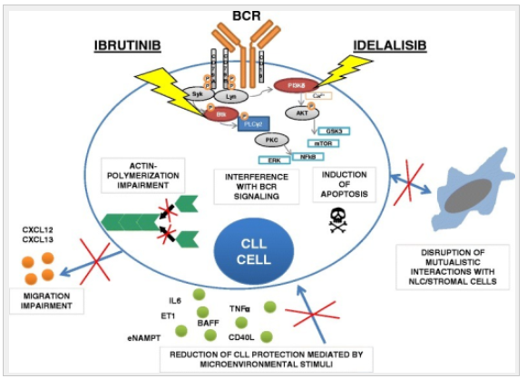
Ibrutinib and Idelalisib Interfere with BCR Signaling to Inhibit Pro-Survival Pathways in CLL Cells
PI3Kδ
Btk
Maffei R, et al. J Hematol Oncol. 2015;29;8:60.
Notes:
Practicing Personalized Evidence-based Medicine in CLL through Risk Stratification and Patient Education
© 2017 MediCom Worldwide, Inc.

Slide 18
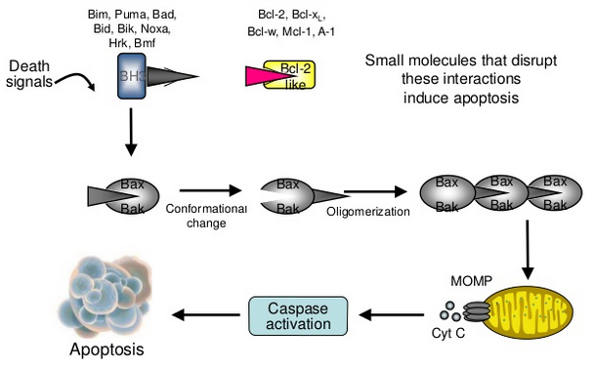
Venetoclax Inhibits Bcl-2, an Anti-Apoptotic Protein that can be Overexpressed in CLL Cells
VENCLEXTA [prescribing information]. South San Francisco, CA: Genentech; 2016.; Mulligan S. Breakthroughs in chronic lymphocytic leukemia 2014 - 2015. Presented at: Asia Pacific Hematology Consortium/Bridging the Gap 2015. February 1, 2015.
Notes:
Practicing Personalized Evidence-based Medicine in CLL through Risk Stratification and Patient Education
© 2017 MediCom Worldwide, Inc.

Slide 19
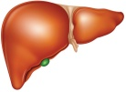
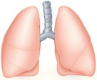
Balance Exposure to Prior Therapy with Comorbid Conditions to Guide Treatment Selection
Treatment guided by:
Prior Therapy
Patients who relapse after ibrutinib and/or idelalisib can be treated with venetoclax
Presence of Comorbidities
Comorbidities guide therapy if patients do not have prior exposure to newer agents
Ibrutinib
AFib
Bleeding
Anticoagulant or Antiplatelet
Idelalisib
Liver Toxicity
Lung Toxicity
Colitis
Venetoclax
Impaired Renal Function
Imbruvica [prescribing information]. Sunnyvale, CA: Pharmacyclics, LLC 2016.; Zydelig [prescribing information]. Foster City, CA: Gilead Sciences, Inc. 2014.; VENCLEXTA [prescribing information]. North Chicago, IL: AbbVie Inc. 2016.
Notes:
Practicing Personalized Evidence-based Medicine in CLL through Risk Stratification and Patient Education
© 2017 MediCom Worldwide, Inc.

Slide 20
NCCN Updated their Guidelines for Relapsed/Refractory CLL in September 2016
del(17p)-Positive Disease:
Panel no longer recommends fludarabine-based chemoimmunotherapy in 1st-line
Disagreed on obinutuzumab + chlorambucil
Favor non-chemo (ibrutinib or immuno)
Category 2A recommendation for ibrutinib, idelalisib or venetoclax in R/R CLL
Ibrutinib or idelalisib + rituximab if not previously treated with kinase inhibitor
del(17p)-Negative Disease:
Ibrutinib or idelalisib + rituximab for treatment at relapse in all subgroups
NCCN Clinical Practice Guidelines in Oncology. Chronic Lymphocytic Leukemia. Version 1.2017
Notes:
Practicing Personalized Evidence-based Medicine in CLL through Risk Stratification and Patient Education
© 2017 MediCom Worldwide, Inc.

Slide 21
Pharmacists Evaluate Drug Metabolism and Transport to Manage Drug-Drug Interactions
Modifying the treatment regimen to optimize safety and efficacy
Managing interactions with concomitant medications is critical
Drug | Cytochrome P450 Pathway |  |  |  |  | Transporters |  | Other
 | 3A4/5 | 2C19 | 2C9 | 2C8 | 2C19 | P-gly | BCRP
Ibrutinib | ▲
Idelalisib | ▲ X_{Strong} | X_{Weak} |  | X_{Weak} |  |  |  | ▲UGT1A4
Venetoclax | ▲ |  | X_{Weak} | X_{Weak} |  | ▲ | ▲ | X UGT1A1
P-gly=P-glycoprotein; BCRP=breast cancer resistance protein; UGT=uridine diphosphate glucuronosyltransferase; X=inhibitor; ▲=substrate
Imbruvica [prescribing information]. Sunnyvale, CA: Pharmacyclics, LLC 2016.; Zydelig [prescribing information]. Foster City, CA: Gilead Sciences, Inc. 2014.; Ramanathan S, et al. Clin Pharmacokinet. 2016;55:33-45.; Jin F, et al. Blood. 2013;122:5574.; VENCLEXTA [prescribing information]. North Chicago, IL: AbbVie Inc. 2016.; Jones AK, et al. AAPS J. 2016;18:1192-1202.; Salem AH, et al. J Pharm Pharmacol. 2016;epub DOI:10.1002/jcph.821.
Notes:
Practicing Personalized Evidence-based Medicine in CLL through Risk Stratification and Patient Education
© 2017 MediCom Worldwide, Inc.

Slide 22
CYP3A4 Inhibitors Can Increase Toxicity to Ibrutinib and Venetoclax
Ibrutinib
Venetoclax
Ibrutinib
Venetoclax
Notes:
Practicing Personalized Evidence-based Medicine in CLL through Risk Stratification and Patient Education
© 2017 MediCom Worldwide, Inc.

Slide 23
CYP3A4 Inhibitors Can Increase Toxicity to Ibrutinib and Venetoclax
CYP3A4 inhibitor
+
Ibrutinib
Venetoclax
Notes:
Practicing Personalized Evidence-based Medicine in CLL through Risk Stratification and Patient Education
© 2017 MediCom Worldwide, Inc.

Slide 24
CYP3A4 Inhibitors Can Increase Toxicity to Ibrutinib and Venetoclax
↑ ibrutinib &
venetoclax
concentrations
↑ ibrutinib &
venetoclax
toxicity
CYP3A4 inhibitor
+
Ibrutinib
Venetoclax
Notes:
Practicing Personalized Evidence-based Medicine in CLL through Risk Stratification and Patient Education
© 2017 MediCom Worldwide, Inc.

Slide 25
CYP3A4 Inducers Can Decrease Efficacy of Ibrutinib, Idelalisib, and Venetoclax
Ibrutinib
Idelalisib
Venetoclax
Ibrutinib
Idelalisib
Venetoclax
Notes:
Practicing Personalized Evidence-based Medicine in CLL through Risk Stratification and Patient Education
© 2017 MediCom Worldwide, Inc.

Slide 26
CYP3A4 Inducers Can Decrease Efficacy of Ibrutinib, Idelalisib, and Venetoclax
CYP3A4 inducer
+
Ibrutinib
Idelalisib
Venetoclax
Notes:
Practicing Personalized Evidence-based Medicine in CLL through Risk Stratification and Patient Education
© 2017 MediCom Worldwide, Inc.

Slide 27
CYP3A4 Inducers Can Decrease Efficacy of Ibrutinib, Idelalisib, and Venetoclax
CYP3A4 inducer
↓ ibrutinib, idelalisib, & venetoclax concentrations
↓ ibrutinib, idelalisib & venetoclax efficacy
+
Ibrutinib
Idelalisib
Venetoclax
Notes:
Practicing Personalized Evidence-based Medicine in CLL through Risk Stratification and Patient Education
© 2017 MediCom Worldwide, Inc.

Slide 28
Common CYP3A4 Inhibitors/Inducers to Consider when Treating Patients with CLL Therapy
Strong CYP3A4 Inhibitors | Moderate CYP3A4 Inhibitors | CYP3A4 Inducers
Boceprevir | Aprepitant | Avasimibe
Clarithromycin | Ciprofloxacin | Carbamazepine
Conivaptan | Diltiazem | Modafinil
Itraconazole | Erythromycin | Phenytoin
Ketoconazole | Fluconazole | Rifabutin
Nefazodone | Imatinib | Rifampin
Posaconazole | Verapamil | St. John’s Wort
Telithromycin
Voriconazole
HIV medications
Drug Development and Drug Interactions Table. http://www.fda.gov/Drugs/DevelopmentApprovalProcess/DevelopmentResources/DrugInteractionsLabeling/ucm093664.htm.;
Indiana University Department of Medicine P450 Drug Interaction Table. http://medicine.iupui.edu/CLINPHARM/ddis/clinical-table.
Notes:
Practicing Personalized Evidence-based Medicine in CLL through Risk Stratification and Patient Education
© 2017 MediCom Worldwide, Inc.

Slide 29
Pharmacists Optimize CLL Therapy through Dose Modifications and Patient Monitoring
CLL Therapy | Interacting Medication | Outcome | Dose Alteration to CLL Drug and/or Required Monitoring
Ibrutinib | CYP3A strong inhibitor | ↑ Cmax 29-fold, ↑ AUC 24-fold | Avoid combination
 | CYP3A moderate inhibitor | ↑ Cmax 5-fold, ↑ AUC 8-fold | ↓ ibrutinib to 140 mg once daily
 | CYP3A strong inducer | ↓ Cmax 13-fold, ↓ AUC 10-fold | Avoid combination
 | Anticoagulants/Anti-platelets | ↑ bleeding risk | Monitor for bleeding
 | CYP3A strong inhibitor/P-gp inhibitor | No ∆ Cmax, ↑ AUC 1.8-fold | Monitor for ibrutinib toxicity
Idelalisib | CYP3A strong inducer/P-gp inducer | ↓ Cmax 58%, ↓ AUC 75% | Avoid combination
 | CYP3A4 substrates | ↑ CYP3A4 substrate Cmax 2.4-fold, ↑ CYP3A4 substrate AUC 5.4-fold | Avoid combination
Venetoclax | CYP3A strong inhibitor | ↑ Cmax 2.3-fold ↑ AUC 6.4-fold | Initiation: Avoid combination; Steady Dose: avoid or ↓ venetoclax by 75%
 | CYP3A moderate inhibitor/ P-glycoprotein inhibitor | ↑ Cmax ↑ AUC | Initiation/Steady Dose: avoid combination or ↓ venetoclax by 50%
 | CYP3A strong inducer | ↓ Cmax 42% ↓ AUC 71% | Avoid combination
 | Warfarin | ↑ Cmax 18% ↑ AUC 28% | Monitor INR or use alternative
 | P-glycoprotein substrates | ↑ Cmax ↑ AUC | Avoid combination or take P-glycoprotein substrate 6 hours before venetoclax
Imbruvica [prescribing information]. Sunnyvale, CA: Pharmacyclics, LLC 2016.; Zydelig [prescribing information]. Foster City, CA: Gilead Sciences, Inc. 2014.; VENCLEXTA [prescribing information]. North Chicago, IL: AbbVie Inc. 2016.
Notes:
Practicing Personalized Evidence-based Medicine in CLL through Risk Stratification and Patient Education
© 2017 MediCom Worldwide, Inc.

Slide 30
Nurses are at the Forefront of Adverse Event Assessment and Intervention
Encourage patients to report AEs immediately in order to address severe AEs
GI effects may be more common than reported
Take diarrhea history (stool consistency; number of stools per 24 hours)
Assess if diarrhea is new onset or chronic
Grade the diarrhea by CTCAE
Counsel on dietary modification for GI effects, including nausea and diarrhea
Notes:
Practicing Personalized Evidence-based Medicine in CLL through Risk Stratification and Patient Education
© 2017 MediCom Worldwide, Inc.

Slide 31
Nurses Must Understand Side-Effect Profiles of CLL Therapy to Monitor and Educate Patients on S/S
Drug | Adverse Event | Signs & Symptoms
Ibrutinib | Atrial Fibrillation | Chest pain | Fatigue | Dizziness
 |  | SOB | Tachycardia | Chest pressure
Idelalisib | Enteric Colitis | Abdominal pain | Cramping | Diarrhea
 |  | Blood in stool | Loss of appetite | Incontinence
 | Diarrhea | Loose stools | Frequent stools | Abdominal pain
 | Hepatotoxicity | Stomach pain | Nausea | Jaundice
 |  | Dark urine | Light stools | Vomiting
 | Bowel Perforation | Stomach pain | Nausea | Vomiting
 |  | Fever | Chills | Hematemesis
 | Pneumonitis | Flu-like s/s | Fever | Chills
 |  | Cough/rales | SOB | Joint pain
Venetoclax | Tumor Lysis Syndrome | N/V/D | Muscle cramps | Fatigue
 |  | ↓ Urination | Fatigue | Irregular HR
SOB=shortness of breath; N/V/D=nausea, vomiting, diarrhea; HR=heart rate
Black box warning
Imbruvica [prescribing information]. Sunnyvale, CA: Pharmacyclics, LLC 2016.; Zydelig [prescribing information]. Foster City, CA: Gilead Sciences, Inc. 2014.; VENCLEXTA [prescribing information]. North Chicago, IL: AbbVie Inc. 2016.
Notes:
Practicing Personalized Evidence-based Medicine in CLL through Risk Stratification and Patient Education
© 2017 MediCom Worldwide, Inc.

Slide 32
Pharmacologic and Non-Pharmacologic Interventions to Manage Adverse Events to CLL Therapy
Agent | Important Adverse Events | Recommended Considerations for Managing
Ibrutinib | Atrial Fibrillation | Exercise caution when initiating anticoagulation
 | Bleeding | Adhere to recommendations for holding drug before and after procedures Exercise caution when initiating anticoagulation or other antiplatelet agents
 | Myalgias/Arthralgias | Often self-limiting, but may respond to anti-inflammatory medications and/or steroids
Idelalisib | Hepatic Transaminases | Check bi-weekly during the first few months of treatment Hold drug when > Grade 5-20 x ULN; re-introduce at reduced dose (ie, 100 mg bid)
 | Colitis | Late occurring (median 6-8 months from starting) Exclude infection, consider colonoscopy for definitive diagnosis Hold drug and administer steroids to treat, but may require permanent discontinuation
 | Pneumonitis | Requires high index of suspicion not to confuse with infection Treat with steroids and consider permanent discontinuation
 | Opportunistic Infections | Routine prophylaxis with TMP/SMX and antiviral (acyclovir or valacyclovir)
Venetoclax | Tumor Lysis Syndrome | Careful risk assessment by disease bulk and renal function (CrCl <80 mL/min) Emphasize adequate hydration and close adherence to recommendations for prevention and laboratory monitoring during dose ramp-up as detailed in the prescribing information
 | Neutropenia | Monitor regularly during the first few months of therapy Responds well and quickly to white blood cell growth factors (ie, G-CSF)
Imbruvica [prescribing information]. Sunnyvale, CA: Pharmacyclics, LLC 2016.; Zydelig [prescribing information]. Foster City, CA: Gilead Sciences, Inc. 2014.; VENCLEXTA [prescribing information]. North Chicago, IL: AbbVie Inc. 2016.
Notes:
Practicing Personalized Evidence-based Medicine in CLL through Risk Stratification and Patient Education
© 2017 MediCom Worldwide, Inc.

Slide 33
Pharmacists Ensure Pharmacologic Safety at All Stages of Treatment
Assess toxicity risk prior to treatment and educate patients on what side effects to expect
Obtain OTC products for expected symptoms and instruct patient when to use OTC vs. contact the health care team, for example:
Loperamide for diarrhea
Corticosteroid creams for rash
Conduct toxicity assessments weekly during the first month of oral therapies via telephone and 1 week prior to prescription refill
Work with the multidisciplinary team to:
Triage medication-related AEs to the care team before refill
Create pharmacist/nurse-initiated protocols for common AEs
Notes:
Practicing Personalized Evidence-based Medicine in CLL through Risk Stratification and Patient Education
© 2017 MediCom Worldwide, Inc.

Slide 34
Shared Decision-Making Incorporates the Patient/Caregiver in Decisions Related to their Care
“It is a process in which clinicians and patients work together to make decisions and select tests, treatments and care plans based on clinical evidence that balances risks and expected outcomes with patient preferences and values.”
National Learning Consortium. https://www.healthit.gov/sites/default/files/nlc_shared_decision_making_fact_sheet.pdf.
Notes:
Practicing Personalized Evidence-based Medicine in CLL through Risk Stratification and Patient Education
© 2017 MediCom Worldwide, Inc.

Slide 35
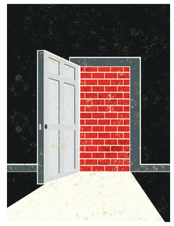
Nurses Play an Integral Role in Patient Counseling and Identifying Barriers to Care
Assist with:
Assessing medication adherence
Identifying barriers to care
Recognizing psychosocial issues
CLL diagnosis can affect relationships, marriages, social support systems and psychosocial well-being
Educate about:
Medication adherence
Patient support resources
Realistic outcomes and goals of therapy
Faiman B. J Adv Pract Oncol. 2011;2:26-34.; Accrodino MK, et al. Am Soc Clin Oncol Educ Book. 2013;2013:271-276.
Notes:
Practicing Personalized Evidence-based Medicine in CLL through Risk Stratification and Patient Education
© 2017 MediCom Worldwide, Inc.

Slide 36
Pharmacists Play an Integral Role in Patient Counseling and Assessing Medication Adherence
Assist with:
Prior authorizations
Reimbursement
Co-pay assistance programs
Tailor dosing strategies to patient’s adherence to medication
Educate about:
Medication adherence
Managing side effects
Medication storage and disposal
Ignoffo R, et al. J Oncol Pract. 2016;12(4):e359-e368.; Holle LM, et al. J Oncol Pract. 2014;10(3):e142-e145.; Parsons LB, et al. J Hematol Oncol Pharm. 2014;5(4):99-108.;
Felton MA, et al. J Oncol Pharm Pract. 2016;22(2):378-381.; Valgus JM, et al. Am J Health Syst Pharm. 2011;68:613-619.
Notes:
Practicing Personalized Evidence-based Medicine in CLL through Risk Stratification and Patient Education
© 2017 MediCom Worldwide, Inc.

Slide 37
Summary
CLL patients are a heterogeneous group and optimal treatment decision-making requires careful attention to both disease- and patient-specific factors
Effectiveness of specific therapies varies by the genetic composition of each patient’s CLL
Recent FISH results, with particular reference to del(17p) status, are vital to prevent patients from receiving ineffective, but potentially toxic therapy
Most CLL patients are older, affected by other illnesses, and take multiple medications
Consider specific comorbid medical illnesses and concurrent medications when selecting among newer agents with similar efficacy
Notes:
Practicing Personalized Evidence-based Medicine in CLL through Risk Stratification and Patient Education
© 2017 MediCom Worldwide, Inc.

